Slide 1
Kattis Practice #6 Recap
Competitive Programming Club

Slide 2
Problem A - Coast Length
Pad one pixel (0) around the grid edge to make it a (n+2)*(m+2) grid.
Color the outer rim of this grid (aka flood fill) with bfs
(dfs is easier to write but recursion can cause stack overflow)
Check for every cell in the grid, if it’s land (1), and is next to the colored pixel, we add 1 to the coast length

Slide 3
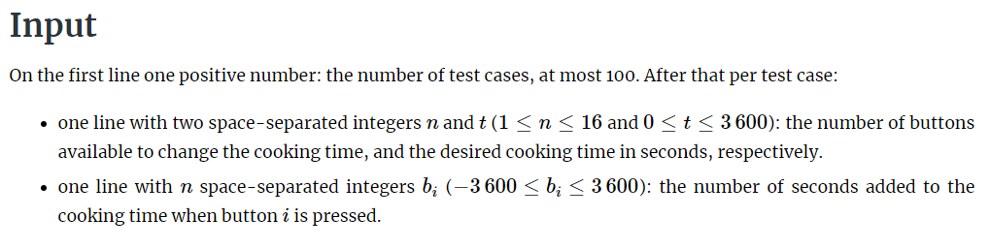
Problem B - Button Bashing Summary
Reach the goal time with the fewest number of button presses and wait time
Able to subtract or add time
When you reach goal time, the wait time is 0
If it is impossible to reach the goal time, minimize the wait time

Slide 4
Commentary
No clear brute force route
Need a search algorithm
Algorithm with negative edges + edge relaxation
Dijkstra? Bellman-ford?
Setup
Array of buttons
Queue of nodes
Array of nodes
Steps
Read in array of buttons
Add the start state of 0 button presses for 0 time to the queue
Update the array of nodes as we go
Stop when we reach the exact time or stop at the end

Slide 5
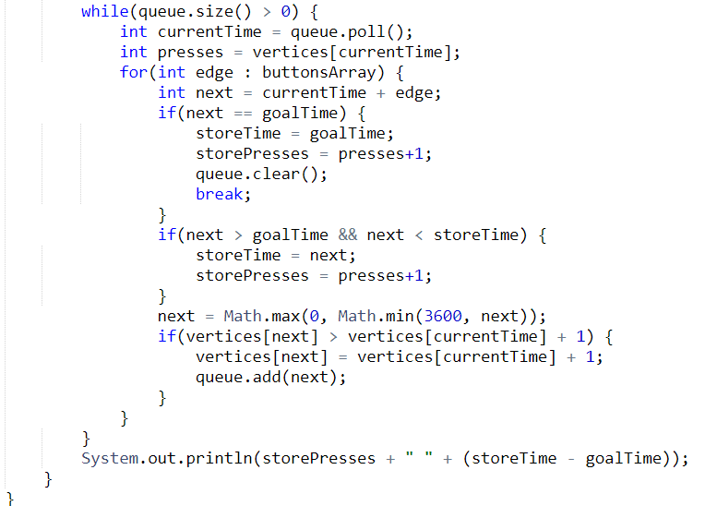
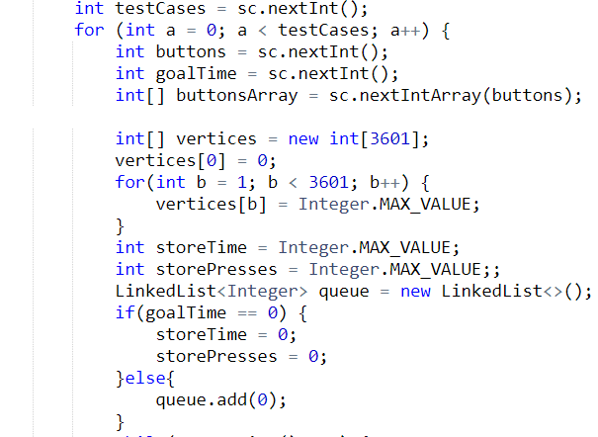
This solution produces WA

Slide 6
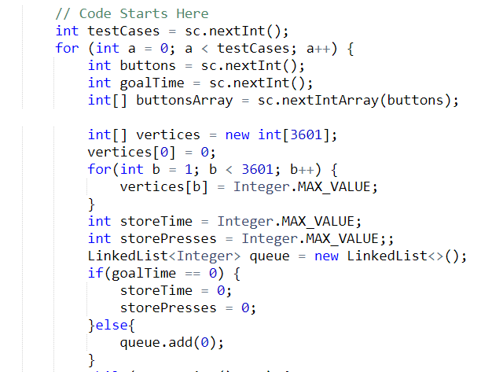
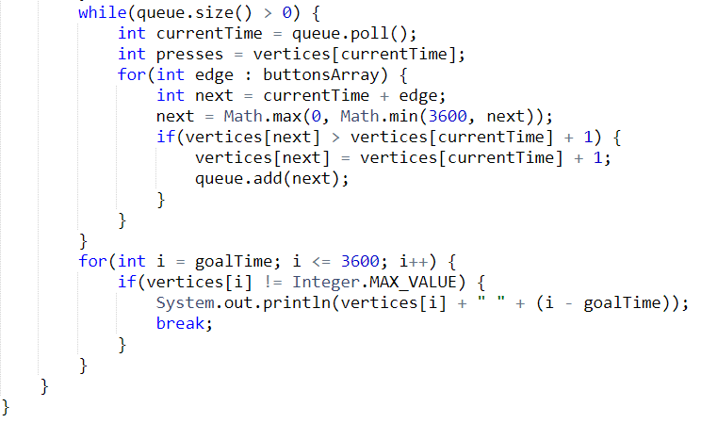
Sample Solution in Java

Slide 7
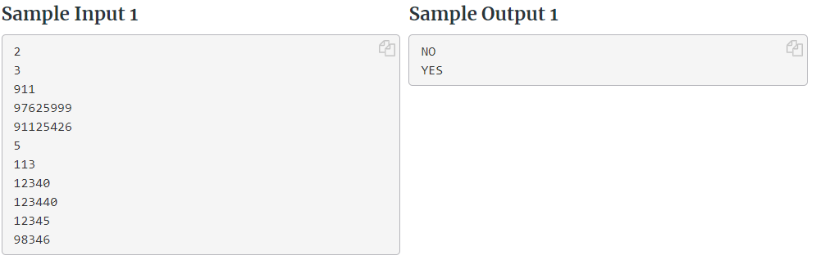
Problem C - Phone List Summary
Determine whether a list of phone numbers is ‘consistent’
Consistent in this case is that no phone number is a prefix of another
40 test cases, 10,000 phone numbers, length 10, in 3 seconds

Slide 8
Commentary
Sorting by length and searching is too slow
Use hashing
Hash the phone numbers and see if the set has its prefix
Setup
Set of phone number strings
Array of phone numbers
Optional variable to store minimum length
Steps
Save the phone numbers in the set and array
Iterate through the array and iterate over the length of the phone number to see if the set contains the prefix

Slide 9
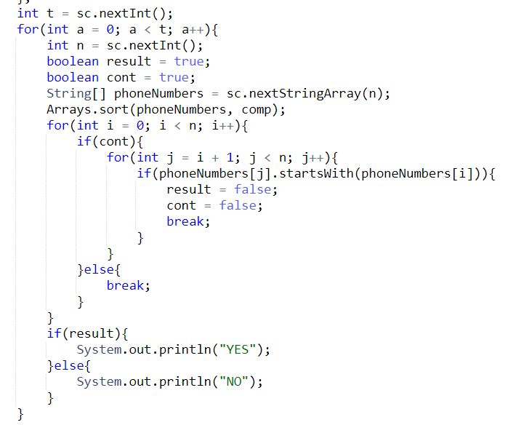
TLE Solution
n
n log n
n
n

Slide 10
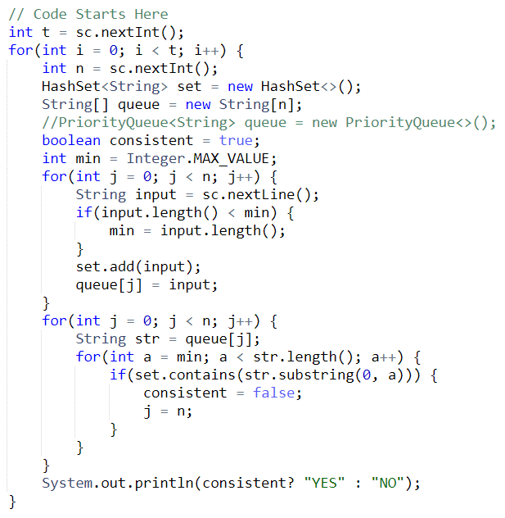
Sample Solution in Java
n
n
10
1

Slide 11
Problem D - Dragon Ball I
Objective: find the length of the shortest path that spans across all of the given cities
Floyd would be too slow, Dijkstra only gives us single source shortest distance
Solution: run dijkstra between all pairs of the targeted city. Calculate the total distance for each eligible path. Find the minimum length.

Slide 12
Problem E - Mountain Biking
Objective: calculate the end velocity of a mountain biker starting at a certain point on a mountain
Solution: Physics! https://www.dummies.com/education/science/physics/how-to-calculate-a-change-in-velocity-based-on-acceleration/
https://github.com/JonSteinn/Kattis-Solutions/blob/master/src/Mountain%20Biking/C/main.c
Function to calculate the end velocity from a given start velocity, starting coordinates, and ending coordinates
For loop to determine end velocity across multiple hill segments. Another for loop to calculate end velocity from each possible starting point

Slide 13
Problem F - Playing the Slots

